Slide 1
Meltdown Spectre Notes

Slide 2
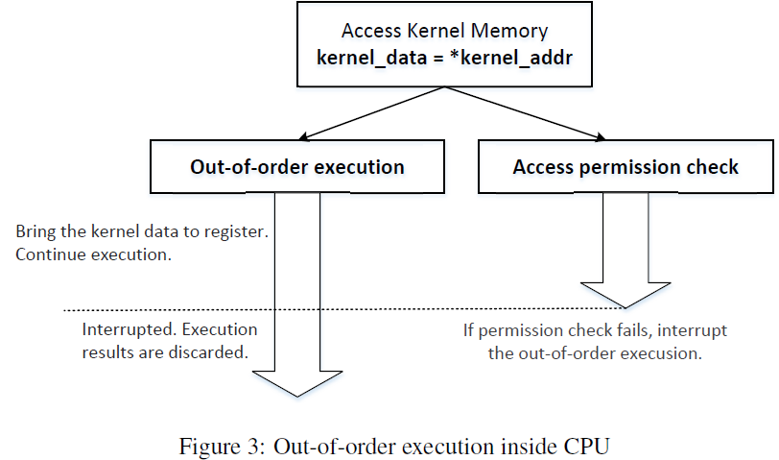
Meltdown
Just before accessing kernel memory address kernel_addr
Is this figure better?
Read memory content *kernel_addr, bringing it into cache during this process
Kernel_data=*kernel_addr
Access Permission Check

Slide 3
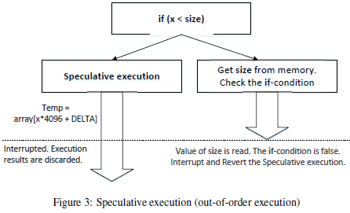
Spectre
In Listing 4: SpectreAttack.c,
size_t larger_x = (size_t)(secret - (char*)buffer);
spectreAttack(larger_x);
If we flush both larger_x and size to memory before calling spectreAttack(), would it increase probability of success, since both variables need to be read from memory?
Just before if (x<size)
Speculative Execution of wrong branch.
Get x and size from memory, check the if condition
Is this figure better?

Slide 4



Meltdown Attack Analogy
Secret: 7
Guard with
Memory Eraser
Restricted Room
Bob has a secret (say 7) inside the restricted room. You want to steal the secret, but you do not have the security clearance to enter the room.
Outside of the room: you prepare 10 lightbulbs with 10 light switches. All lightbulb-to-switch connections are known, and you fully control them anytime and anywhere (wirelessly).
The security guard is busy. He usually stops you from entering the room, but sometimes he tries to optimize performance and lets you into the room regardless of your security clearance. But if he later finds out that you do not have security clearance, he will erase your memory and kick you out.
Q: Can you steal the secret 7 with side channel analysis?
A: Yes. Initially reset all lightbulbs to be off. Try many times to enter the room. If you get lucky and enter the room, see Bob’s secret 7, copy it into your memory by turning on lightbulb #7. The guard later finds out, erases your memory and kicks you out. Once outside, you don’t remember the secret 7 since your memory has been erased, but you can see that lightbulb #7 is on, so you have stolen the secret 7.
Notes:
Suppose all light bulb-to-switch connections are known, and you can reset all lightbulbs to be off without entering the room

Slide 5
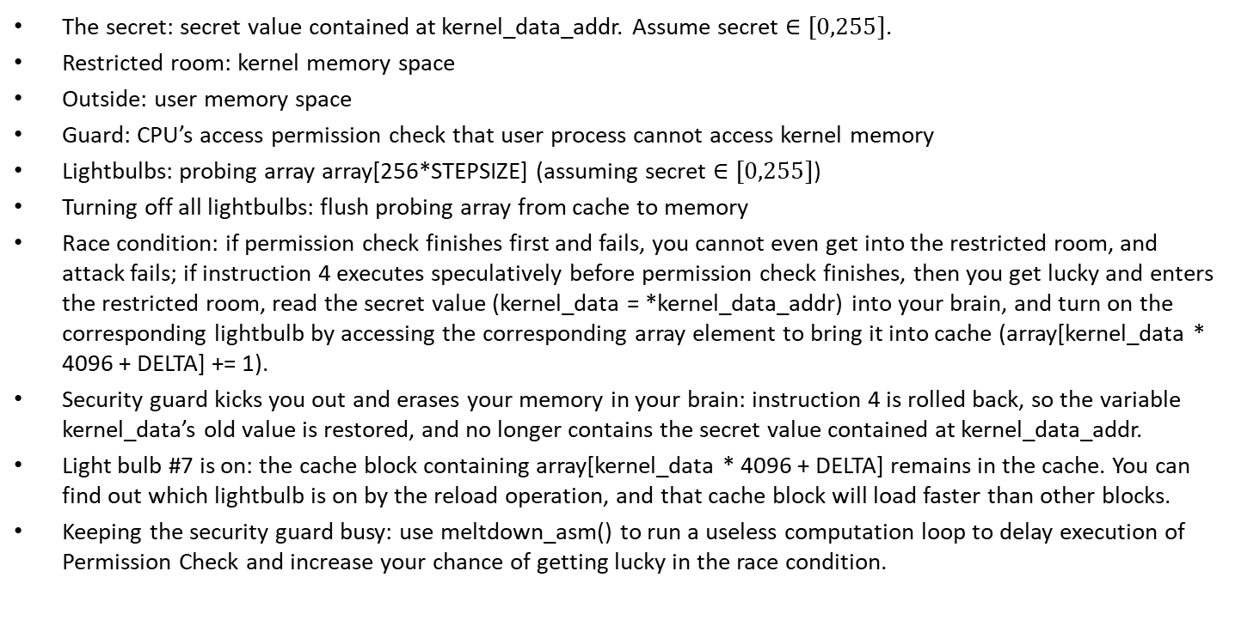
Meltdown Attack Analogy
Secret: 7
Guard with
Memory Eraser
The secret: secret value contained at kernel_data_addr. Assume secret $∈[0,255]$.
Restricted room: kernel memory space
Outside: user memory space
Guard: CPU’s access permission check that user process cannot access kernel memory
Lightbulbs: probing array array[256*STEPSIZE] (assuming secret $∈[0,255]$)
Turning off all lightbulbs: flush probing array from cache to memory
Race condition: if permission check finishes first and fails, you cannot even get into the restricted room, and attack fails; if instruction 4 executes speculatively before permission check finishes, then you get lucky and enters the restricted room, read the secret value (kernel_data = *kernel_data_addr) into your brain, and turn on the corresponding lightbulb by accessing the corresponding array element to bring it into cache (array[kernel_data * 4096 + DELTA] += 1).
Security guard kicks you out and erases your memory in your brain: instruction 4 is rolled back, so the variable kernel_data’s old value is restored, and no longer contains the secret value contained at kernel_data_addr.
Light bulb #7 is on: the cache block containing array[kernel_data * 4096 + DELTA] remains in the cache. You can find out which lightbulb is on by the reload operation, and that cache block will load faster than other blocks.
Keeping the security guard busy: use meltdown_asm() to run a useless computation loop to delay execution of Permission Check and increase your chance of getting lucky in the race condition.
Restricted Room
Notes:
Turning on the light switch that encodes the secret 7: bring element array[7*STEP] into the cache
(assuming security guard and you share the same CPU core

Slide 6
Meltdown Attack Analogy
Lightbulbs | Your memory in your brain | Guard erasing your memory
Attacker’s probing array for FLUSH+RELOAD array[256*STEPSIZE] | Attacker program reads the secret value into variable kernel_data = *kernel_data_addr) | CPU rollbacks variable assignment to kernel_data, but cannot affect cache contents (turn off the lightbulb that you have turned on before to encode the secret *kernel_data_addr)
Notes:
Plays two rolessimultaneously
1) variable assignment to kernel_data in memory AND
2) Probing array in cache
N/A
Rollback value of 1) kernel_data (turn off lightbulbs) but cannot affect 2) the probing array (lightbulb stays warm)

